Slide 1
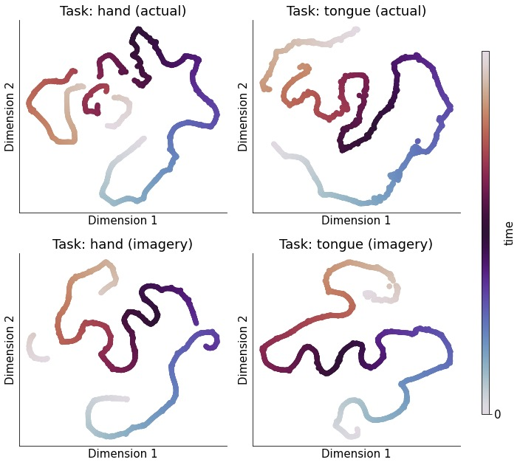
include power calculation

Slide 2
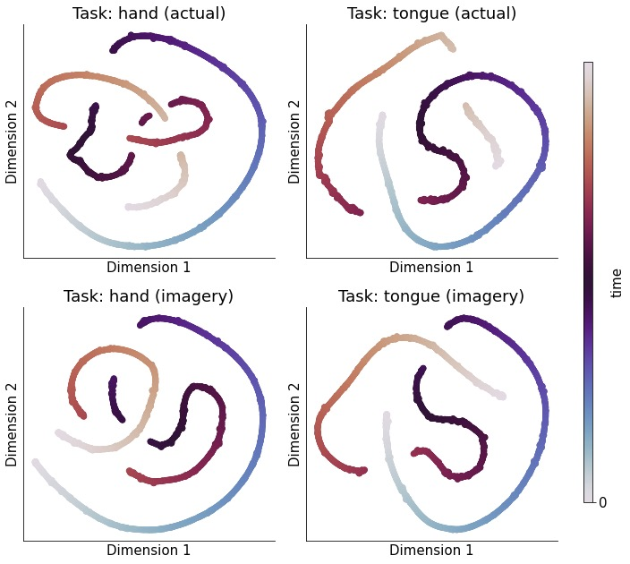
low pass: band limit [1,200]

Slide 3
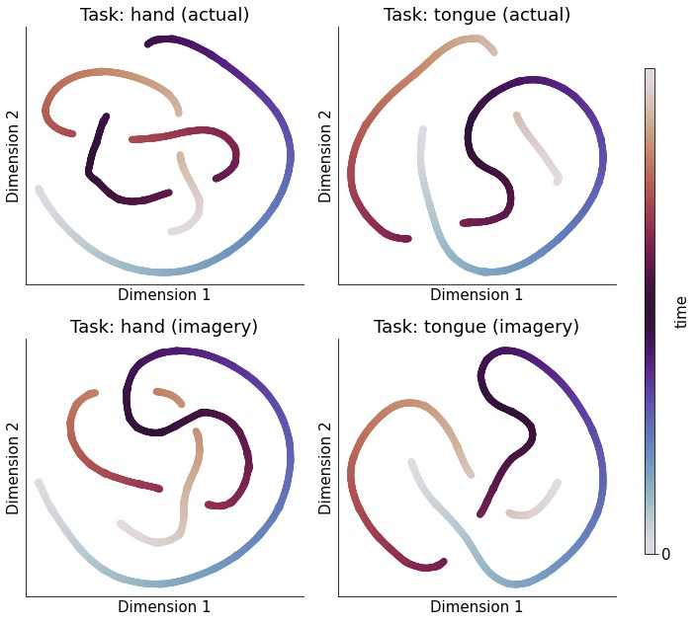
no power calculation, band limit [1,50]

Slide 4
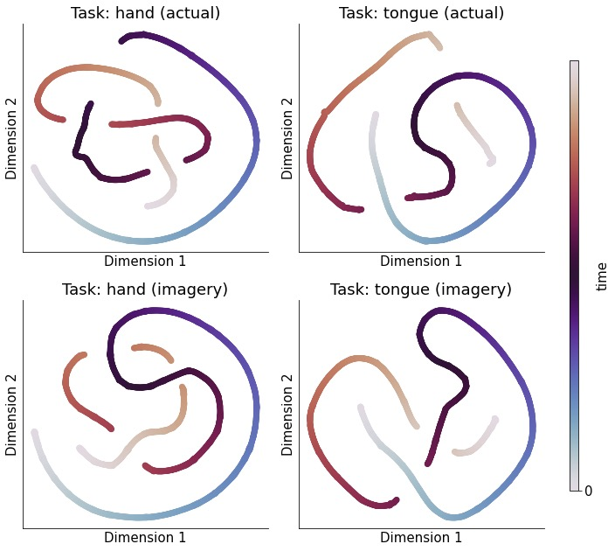
no power calculation, band limit [1,80]

Slide 5
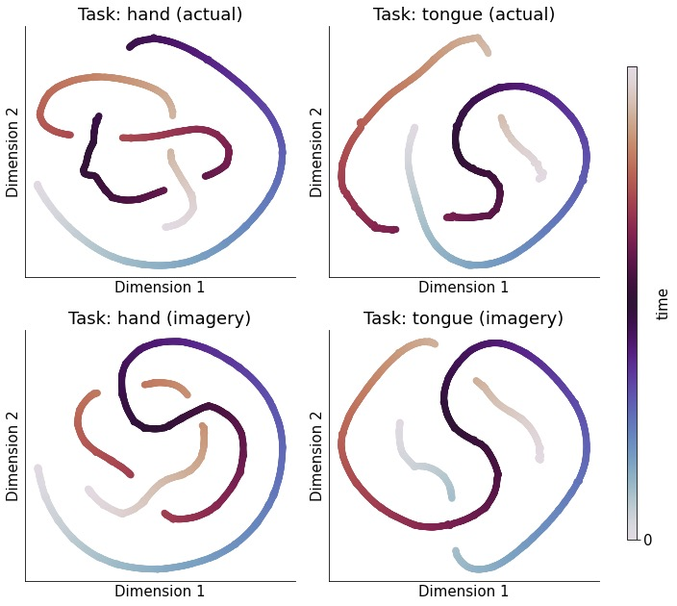
no power calculation, band limit [1,100]

Slide 6
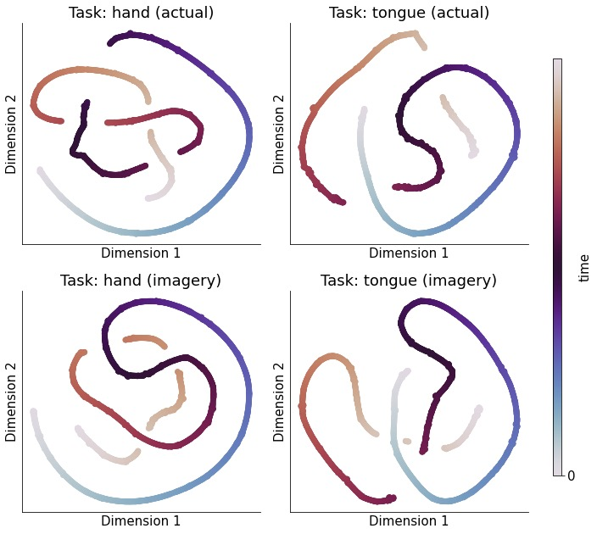
no power calculation, band limit [1,150]

